Slide 1
“No Success
Without
A Successor”

Slide 2
Brief History
1887 – Chicago Hebrew Mission
1953 – American Messianic
Fellowship
1992 – AMF International
2008 – Life in Messiah Int’l (LIFE)

Slide 3
Brief History
Director | Begin | End | Yrs.
None | 1887 | 1890
William E. Blackstone | 1891 | 1892 | 2
Rev. Bernhard Angel | 1893 | 1894 | 2
Rev. JW Marcusson | 1895 | 1896 | 2
Mrs. TC Rounds | 1897 | 1917 | 21
Rev. Norman Camp | 1918 | 1922 | 5
Rev. Charles Meeker | 1923 | 1939 | 17

Slide 4
Brief History
Director | Begin | End | Yrs.
Rev. Milton Lindberg | 1940 | 1961 | 22
Rev. Archie MacKinney | 1962 | 1970 | 9
Rev. Alex Koval | 1970 | 1973 | 4
Rev. William E. Currie | 1974 | 1989 | 16
Rev. Wesley Taber | 1990 | 2017 | 28

Slide 5
Personal Journey
Nov. 1975 – Internship
Spring 76 – Jewish studies at Moody
‘76-’80 – Miami “greenhouse years”
‘80-’82 – Israel “desert years”
’82-’89 – Chicago (includes tough years)
’90-present – Director

Slide 6
Succession Planning
Life in Messiah Board Meeting
November 2014

Slide 7

“Succession planning is becoming particularly important as the baby boomer generation nears retirement age. Recent articles are stressing that 50 to 75% of non profit leadership will be retiring within the next five to eight years. This is expected to create a limited pool of candidates and a leadership gap in the nonprofit community. Many boards are creating a plan or road map on how they would go about replacing/filling key leadership positions.”
Notes:
Leadership turnover is a national phenomenon.

Slide 8
Replacement planning
vs.
Succession planning
What’s the difference?
Replacement planning
vs.
Succession planning
What’s the difference?
  RP – A one-time event
  SP – An ongoing process
Notes:
Why an ongoing process? Look around the room. How many of us will still be serving LIFE in our current capacity in 5 to 8 years?

Slide 9
Competency & Capability
vs.
Culture & Organizational Fit
In a hire situation, where is the focus?
Competency & Capability
vs.
Culture & Organizational Fit
In a hire situation, where is the focus?
  Overwhelmingly, on the task & skills side.
  Which one do you think is the greater cause of early pastor or exec departure?

Slide 10
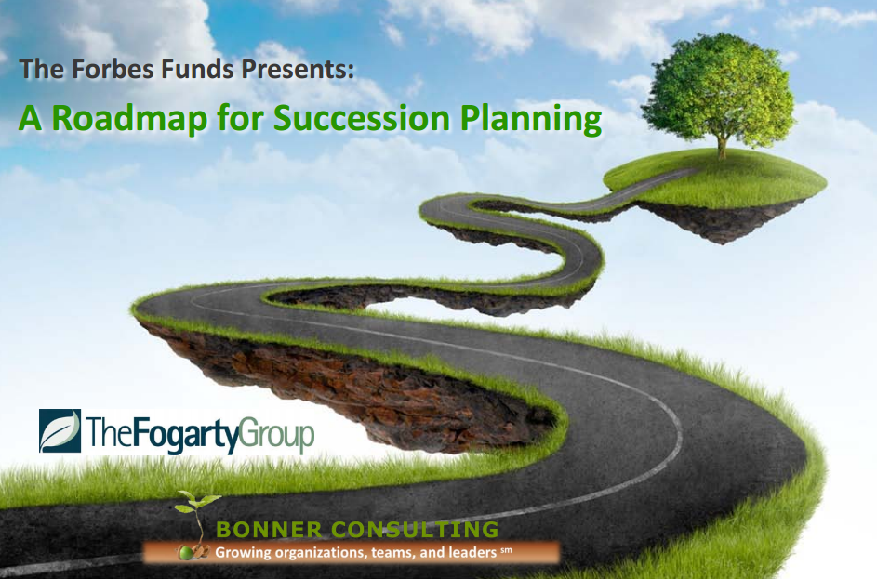
Notes:
You saw a slide from one organization at the beginning. Here’s another and there are two more coming up. There is an overarching commonality to the succession planning process and no substantive differences in the four represented herein. What you’ll see in the next few minutes is illustrative of the research we four independently dug up and shared with each other.

Slide 11
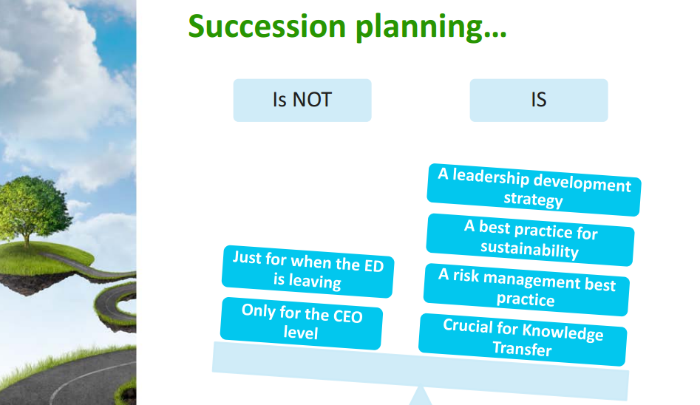

Slide 12
3 Types of Succession Planning
Strategic Leader
Development
Common
Basis
Emergency
Plan
Departure
Defined

Slide 13
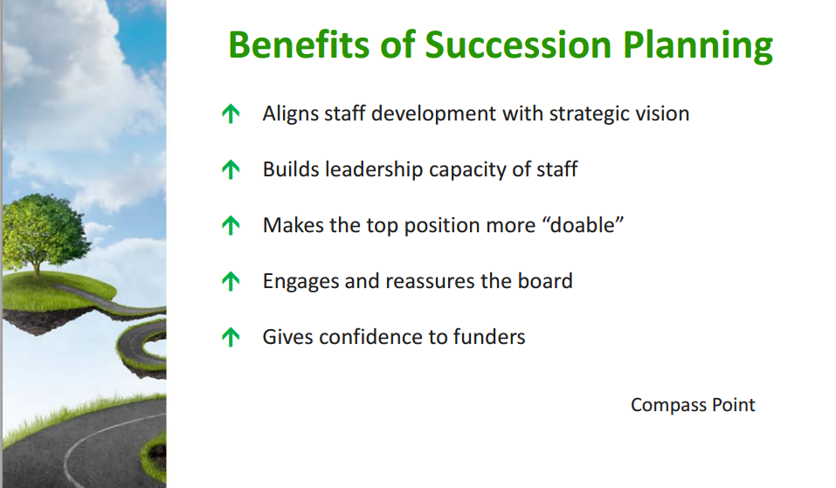

Slide 14
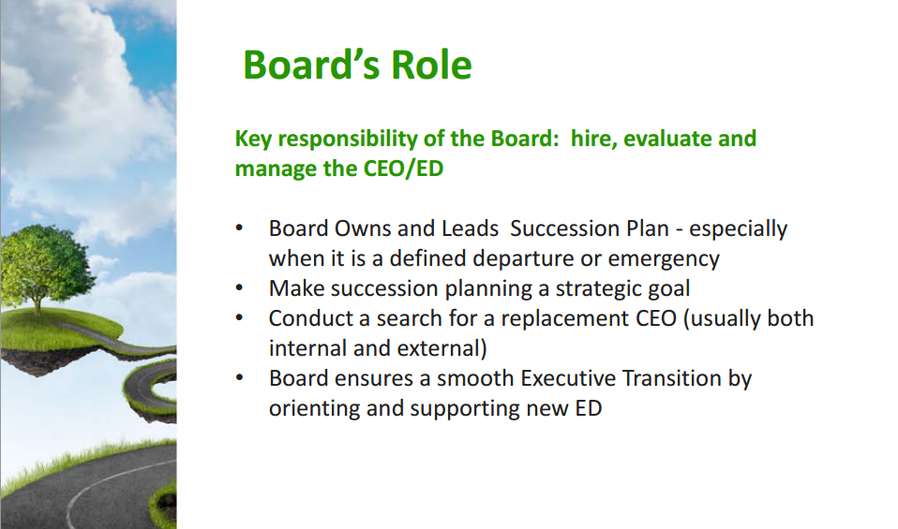

Slide 15
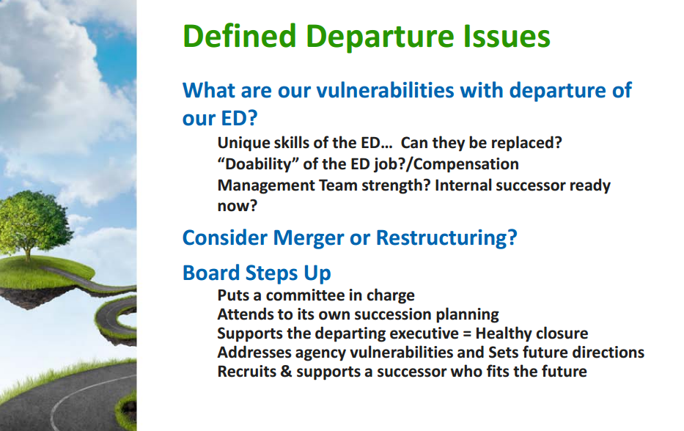

Slide 16
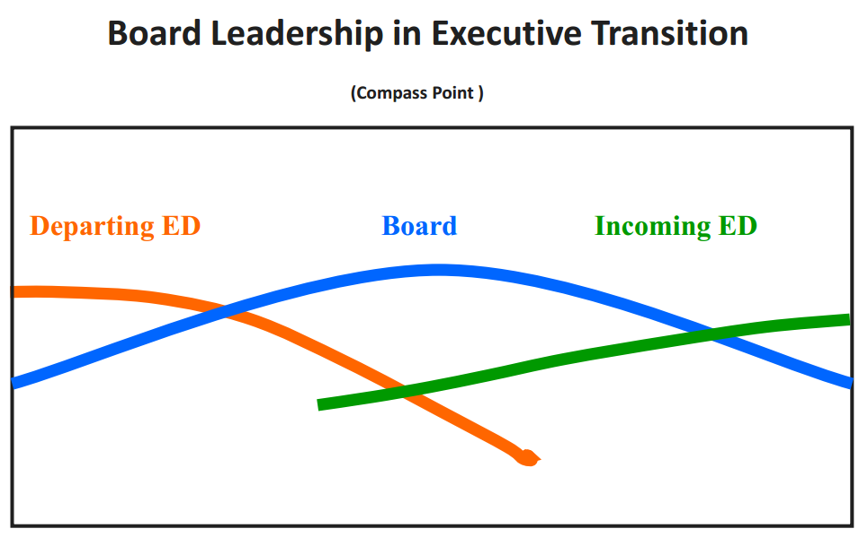

Slide 17
Board Role in
“Leadership Sharing”
Transition
Current
ExD
Shared Leadership
Period
New
Role
Board
Role
Incoming
ExD

Slide 18
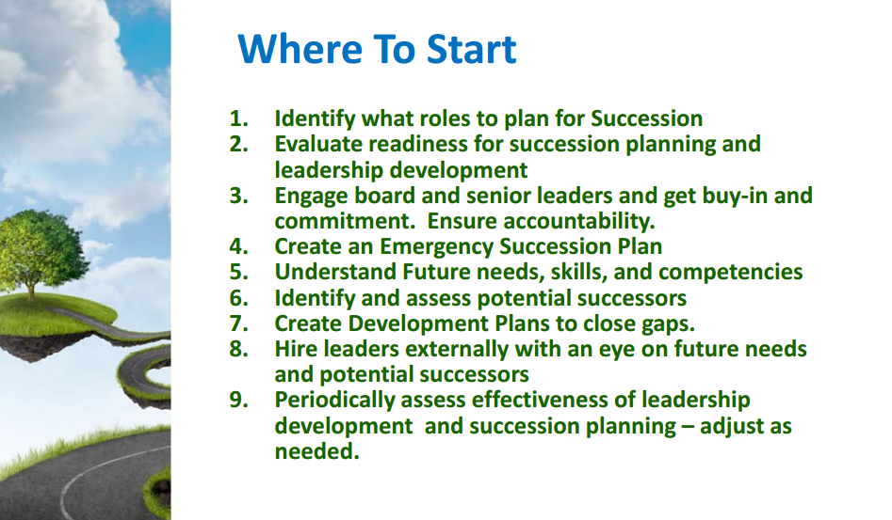

Slide 19
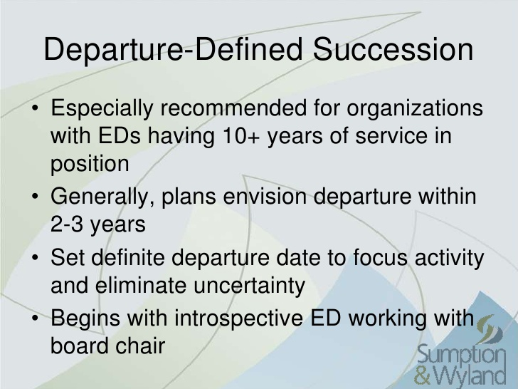

Slide 20
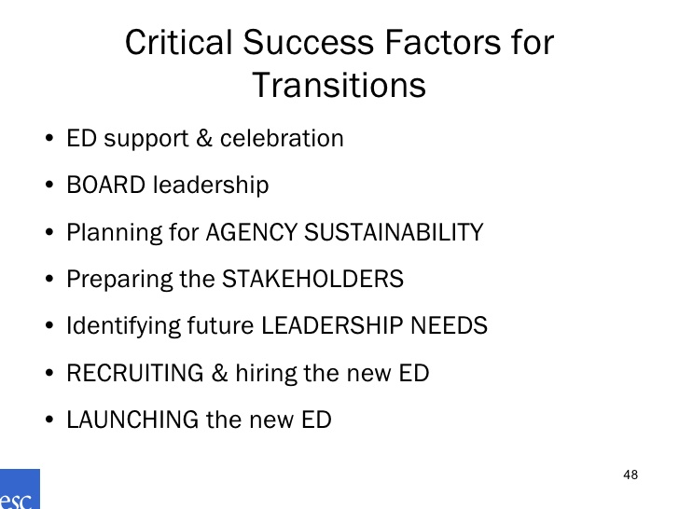

Executive Service Corps of Chicago

Slide 21
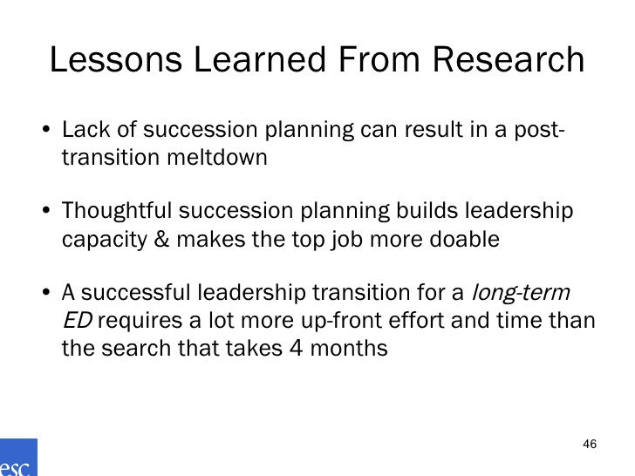
Executive Service Corps of Chicago

Slide 22
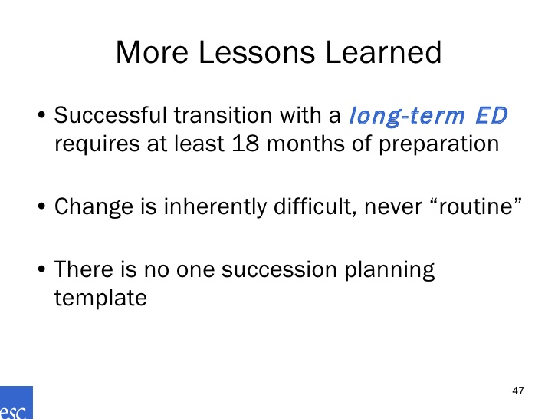
Executive Service Corps of Chicago

Slide 23
Steps
Readiness
  Board, Organization, & Donor Base
Planning
  SWOT, CSFs, & Process for each step of the ‘Execution’ phase
Execution
  Communication, Search, Evaluation, Selection, & Transition
Notes:
Readiness – Ensure every part of the ministry is prepped for the change process.
Planning
SWOT analysis – The strengths, weaknesses, opportunities and threats
CSFs – Critical Success Factors defined. CSFs should be derived from the SWOT analysis.
What must the new ExD have to maintain our current strengths AND grow us where we are weak?
What are the key opportunities and threats we want the new ExD to address?
Process – Who are we seeking and how will we find them?
Who – No one person is likely to have everything we want. (If they do, they’re probably ready for retirement!) What are the “must have” characteristics and what are the “desired” attributes? How will we bridge the gap/grow the new ExD?
Search – Define internal and external search parameters
Execution
Communication: Externally, within the board, to the organization, and specifically to the our support base
Search: Find candidates
Evaluation: Review all applicants and shortlist
Selection: Pick top candidate, recommend to board, make decision, and make offer
Transition: More than “Welcome aboard”

Slide 24
Two Teams
Readiness
Concurrent
Activities
Execution
Planning
Notes:
Two different teams. The readiness and planning must both be finished before the Execution step, but the work can be done concurrently.

Slide 25
Timeline
18 Months
Readiness
4 to 5 Months
Concurrent
Activities
Execution
Planning
Total: 22 to 24 Months
Notes:
Timeline markers are important. It’s easy for time to “slip away” (people are busy). Someone needs to be “ruthless” in keeping things moving.

Slide 26
God’s Leader in His Time
Praying
Concurrent
Activities
3. Trusting
Processing
“Unless the Lord builds the house…”
Notes:
We acknowledge, from the beginning and throughout the process, that LIFE is God’s ministry. We seek His direction, from the beginning and throughout the process. We trust His hand to guide both in our decisions and in the lives of those who will apply to serve. In every case, we seek to bring Him glory in the way we conduct the process and treat applicants.

